Slide 1

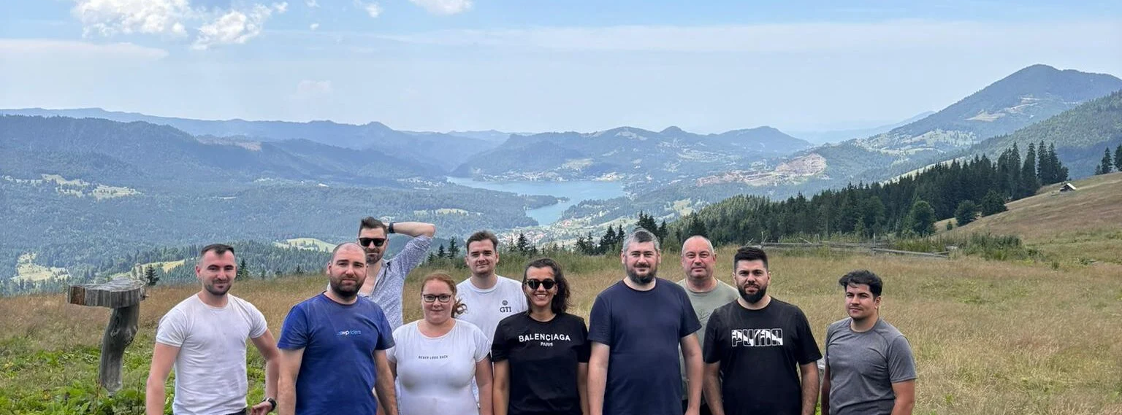
Year in Review
2024 Edition

Slide 2
Team Achievements in 2024
Increased our customer satisfaction score from 9.2/10 in 2023 to an impressive 9.6/10 in 2024, reflecting our commitment to delivering excellence.
Began business development in Switzerland, opening doors to new opportunities in a high-potential region.
Released DocsFromTemplate, our first-ever plugin 100% developed by WPRiders resources.

Slide 3
Team Achievements in 2024
Successfully launched two AI-powered projects:
  ChatGPT Translator for Messages
  Amaya AI Chatbot
Took significant steps to expand our services and begin specializing in Webflow and Shopify development, aligning with market trends.
Our social initiatives and community contributions helped over 3700 kids from rural areas of Romania have access to better education.
In 2024 we have 29 active clients, with 21 clients on monthly retainers.

Slide 4
Key Metrics Overview
332 Projects Delivered: That’s 21% more than 2022 and 5.9% less than 2023. 2024 had 251 working days so we delivered more than 1.3 projects for every working day of the year.
18,150 Total Hours Worked: That’s equivalent to working non-stop for over 2 years without sleep! Out of this, 9,287 hours were billable, reflecting how efficiently we turned time into value for our clients.

Slide 5
Key Metrics Overview
343 Tickets Resolved: We tackled the equivalent of resolving nearly 1 complex client request every single day of the year—including weekends and holidays!
Average Customer Lifetime of 27.88 Months: That’s nearly 2.5 years, showing that our clients don’t just choose us—they trust and stay with us long-term.

Slide 6

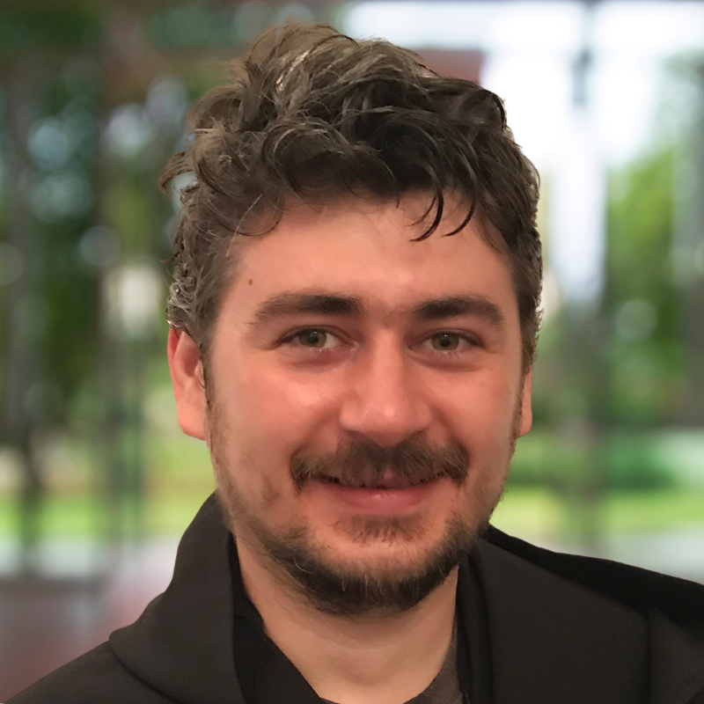
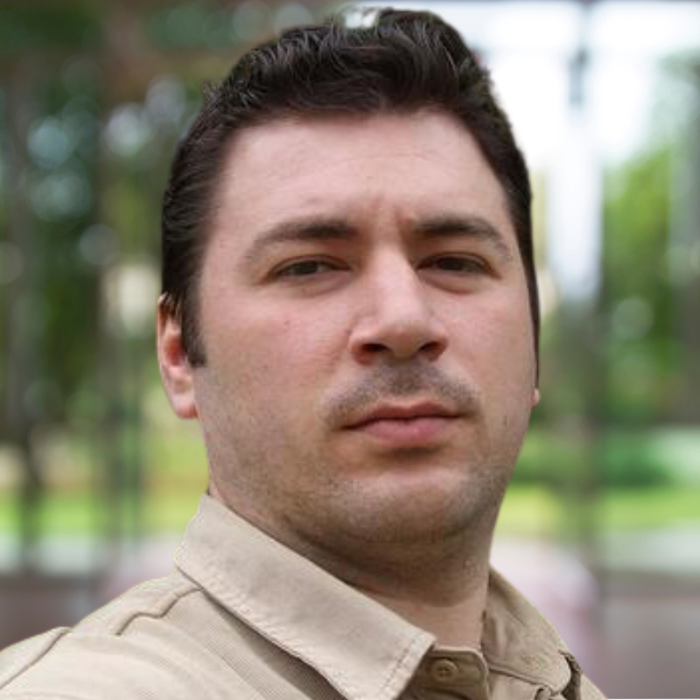
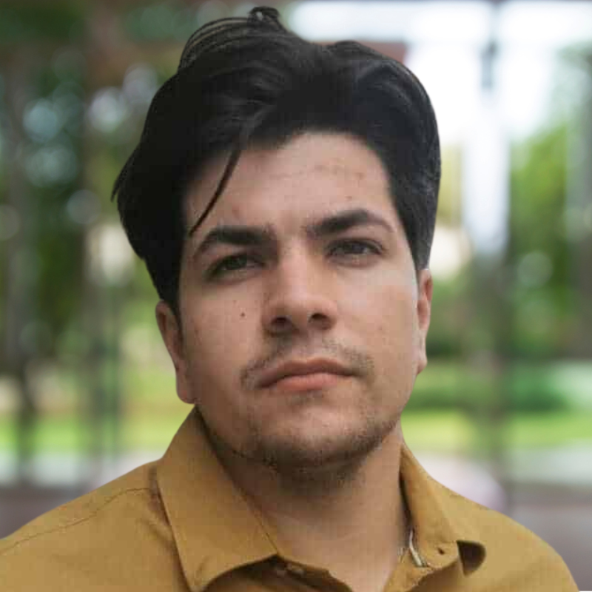

TOP 3 Billable Hours by Developer
Mihai
Ovidiu
Gabi
Special mention - Smit

Slide 7





Client and Partner Highlights
Top 5 customers this year:
1. Cloudways/DigitalOcean
2. Bitdefender
3. TopspinPro.com
4. Panasonic
5. Foreign Policy Association

Slide 8
Long-standing client anniversaries
Will Turnage from bookbarbarian.com has been our client for 8+ years
At the end of December, Xeroom will be working with us for 7 years
This year we had a birthday anniversary of 5 years with Cloudways and 4 years with Bitdefender

Slide 9
Challenges and Lessons Learned

Slide 10
Struggling with Sales and Leads in a Tough Year
Challenge: The entire industry faced a tough year in terms of sales and lead generation. Our outreach efforts via UpWork and Codeable produced limited results.
Lesson Learned: We learned the importance of diversifying our lead generation channels and strengthening relationships with partners. The partnership with another agency in the US has shown promise, and we will continue to refine this model to create more opportunities.

Slide 11
Fixed-Estimate Projects Underperforming
Challenge: Fixed-price projects continued to face budget overruns and missed deadlines, affecting profitability and client satisfaction.
Lesson Learned: We need to improve our project scoping and estimating processes with more detailed planning and clearer communication with clients about project timelines and budgets.

Slide 12
Team’s Openness to Learning, Training, and Innovation
Challenge: We’re not fully open to embracing continuous learning, training, and innovation, which impacts our ability to stay ahead of the curve.
Lesson Learned: We must foster a culture of growth by investing more in training. Encouraging knowledge sharing and making learning resources more accessible can help overcome resistance to change. We’ll prioritize keeping the team engaged with the latest trends

Slide 13
Intense Competition from Low-Cost Providers
Challenge: The competition from low-cost service providers and agencies offering similar services became increasingly fierce this year
Lesson Learned: Competing on value rather than price is crucial. Our focus should be on delivering high-quality, specialized services that offer clear differentiation. We will also emphasize our long-standing client relationships and consistently high customer satisfaction to demonstrate our worth beyond cost.

Slide 14
High-level company goals for next year
Attract successful clients: build on our repositioning efforts to secure bigger, more impactful projects
Deliver excellence: enhance project quality, meet deadlines consistently, and exceed client expectations
Upskill the team: focus on professional development and certifications for team members
Achieve WPRiders growth: set ambitious but achievable sales & financial targets to scale the business further

Slide 15
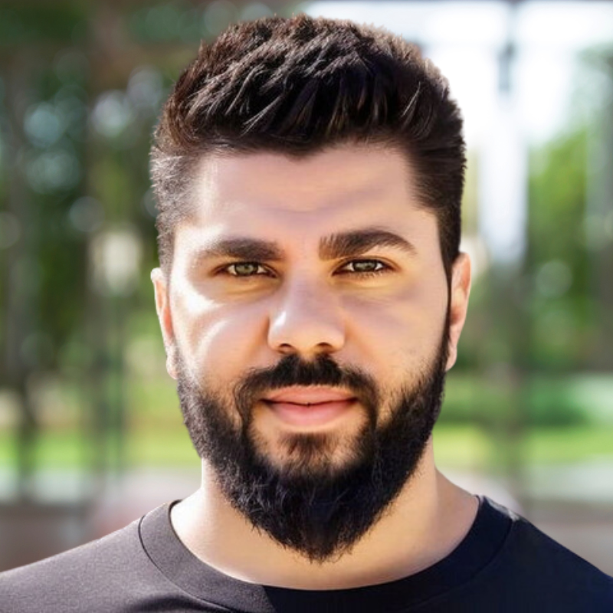
Thank you for your hard work, dedication, and creativity this year. Every success we’ve achieved is a reflection of your efforts, teamwork, and commitment to excellence. Here’s to an extraordinary year ahead!

Slide 16
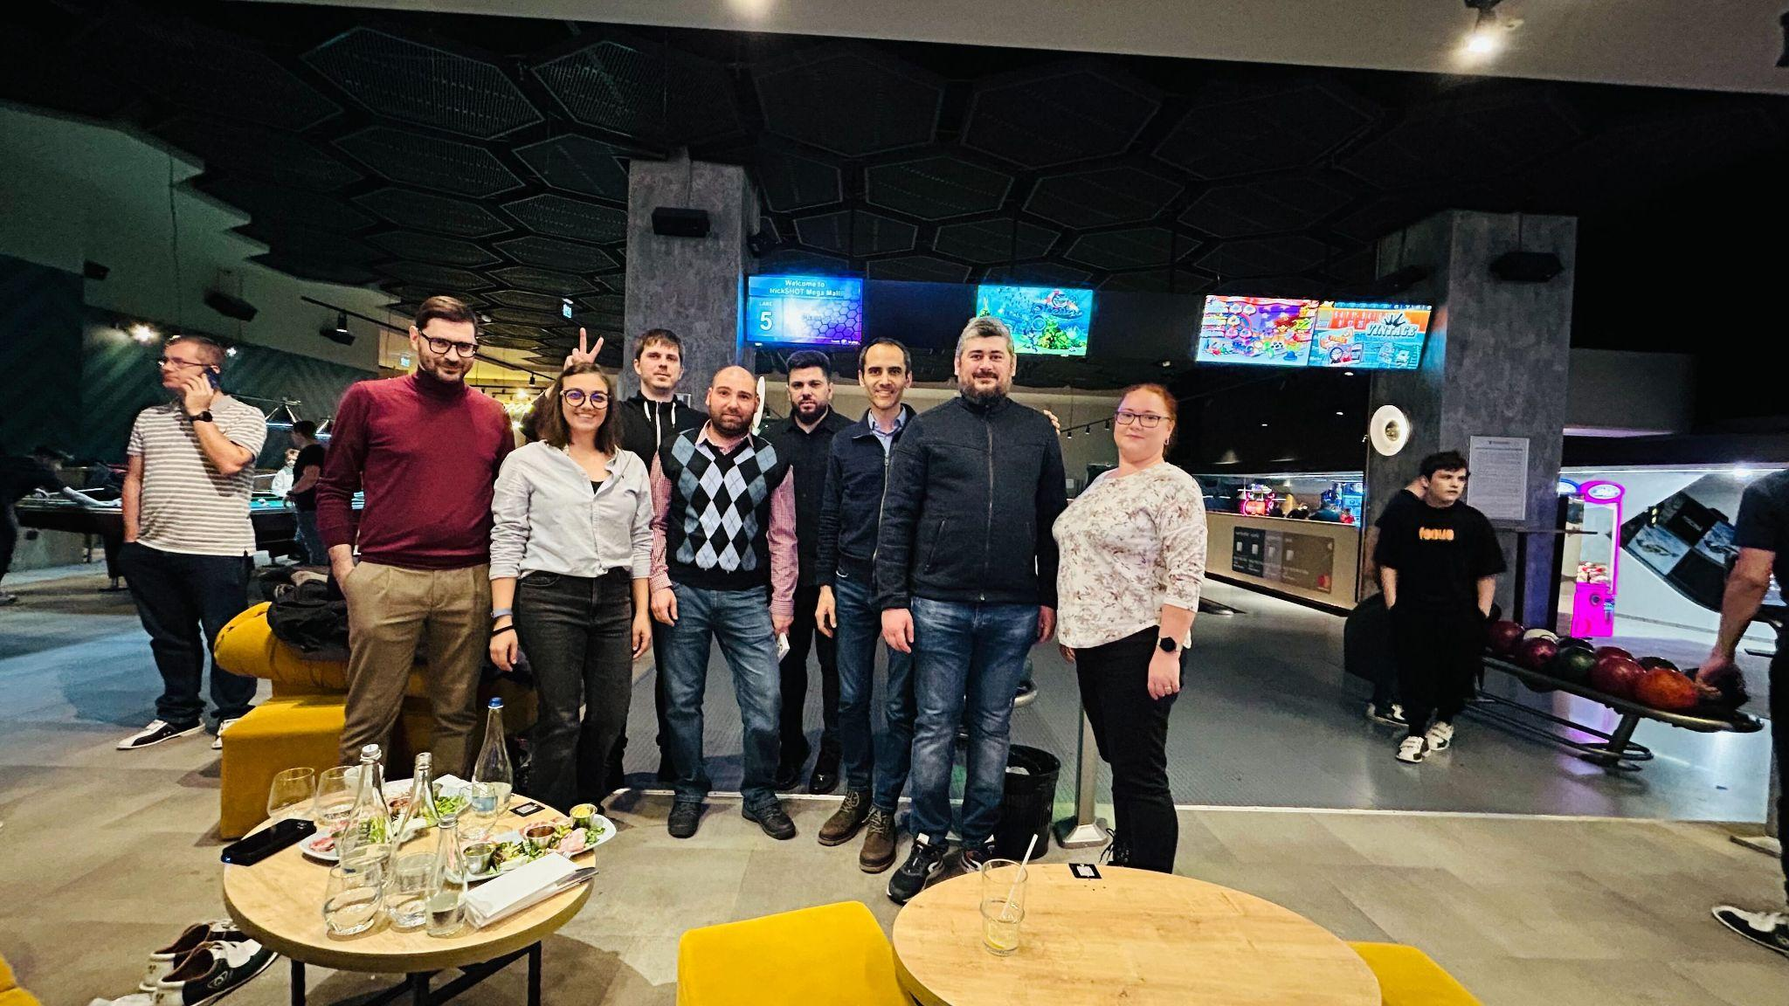
WPRiders Team
Year in Review • 2024 Edition

Slide 17
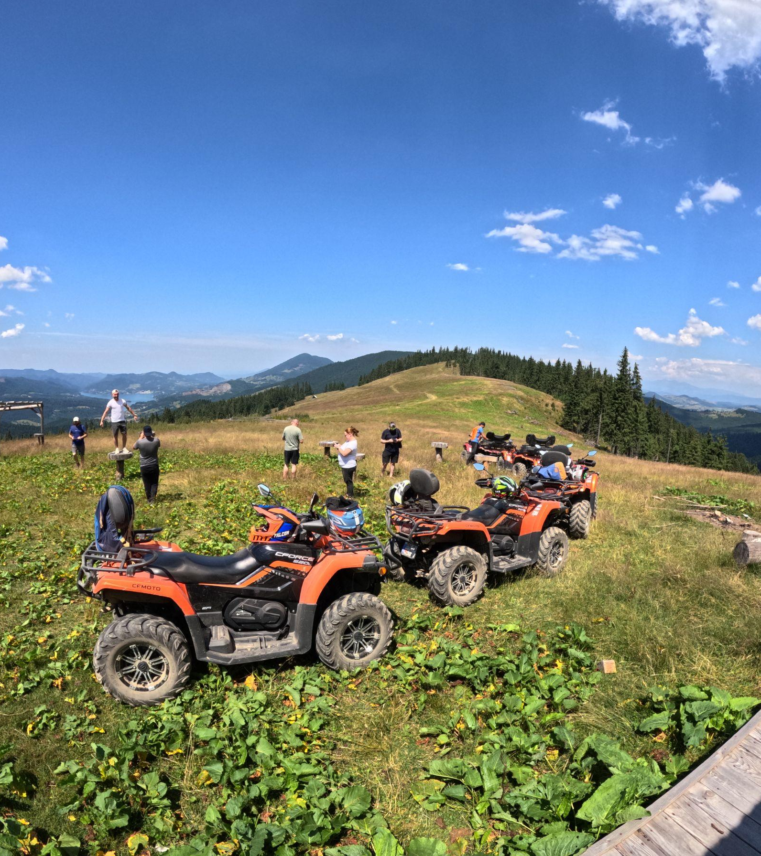
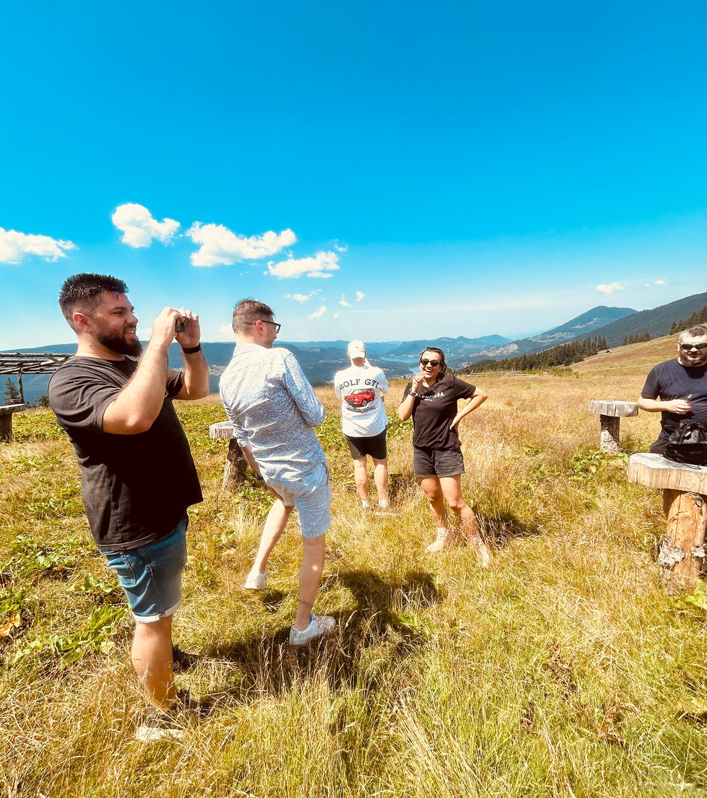
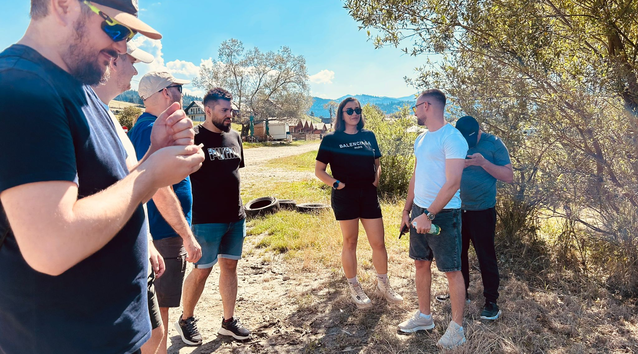
We did great!
What an
amazing year!

Slide 18
4.25 Turnover Rate
9.25 eNPS
16 All-Year Active People

Slide 19
1 Team Building
1 Christmas Dinner

Slide 20

Some TOP 3
Awards

Slide 21

Ready?

Slide 22
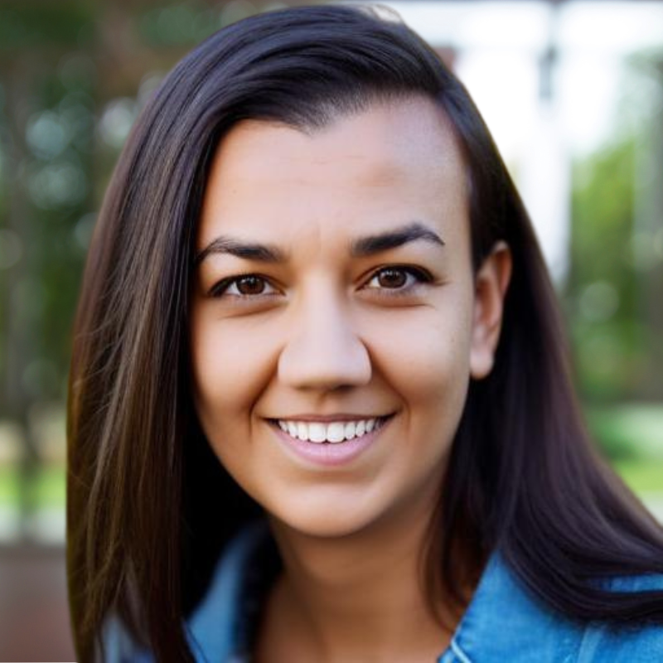
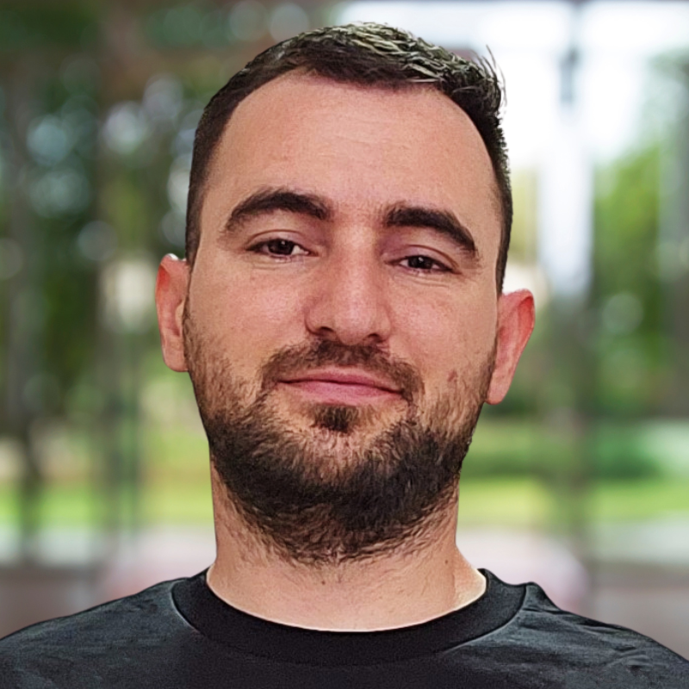
TOP 3 Sharing is Caring Participants
Alexandra - 37 times
Mihai & Oraldo - 34 times
Andrei - 33 times

Slide 23
TOP 3 Random Chat Participants
Alexandra - 44 times
Oraldo - 24 times
Mihai - 18 times

Slide 24
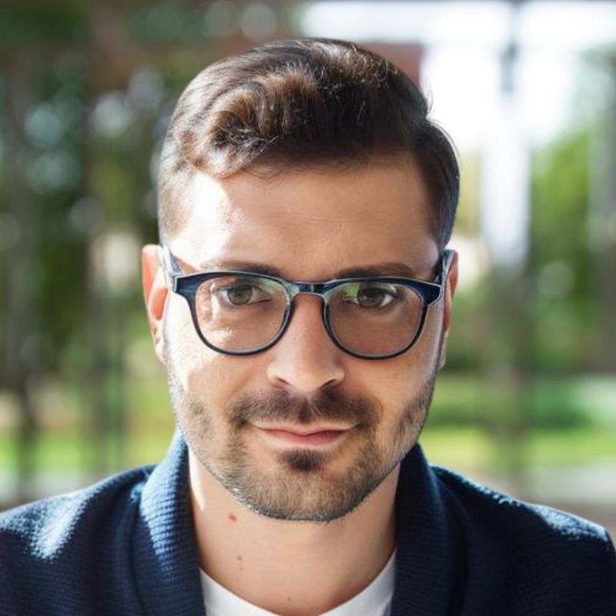
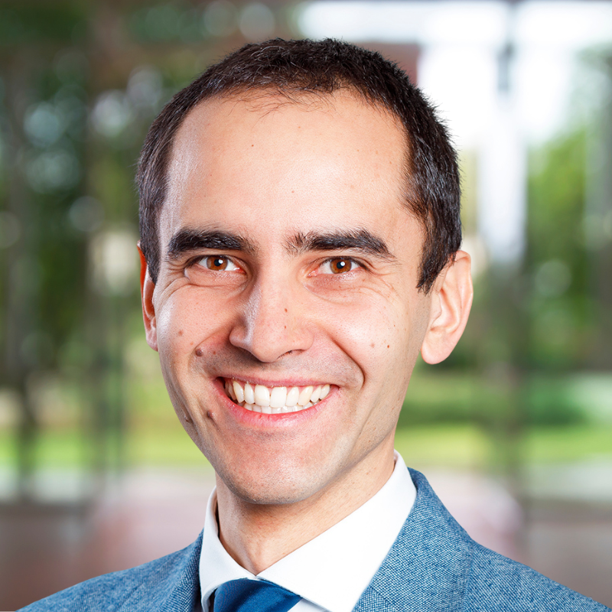
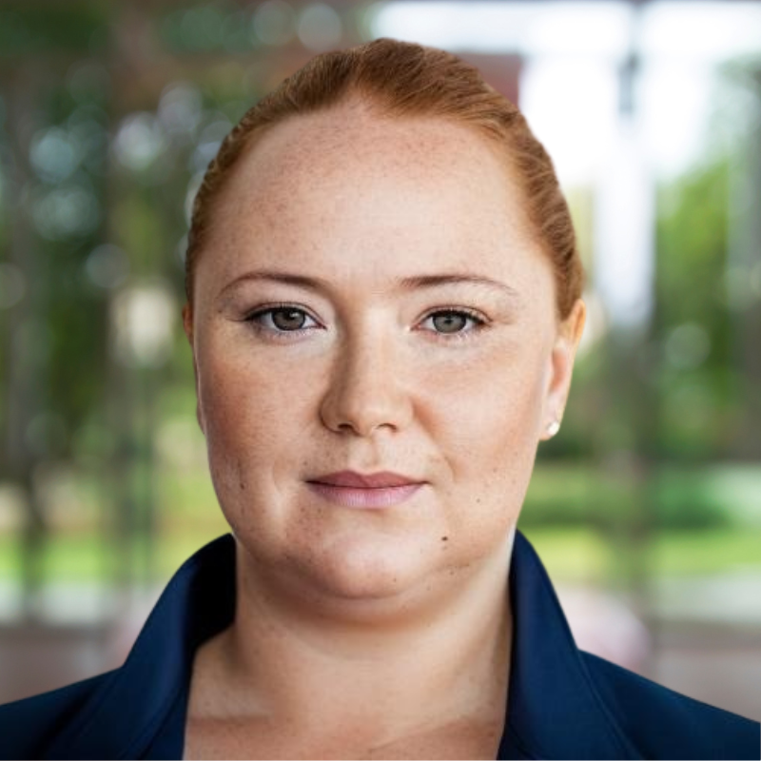
TOP 3 People Offering Certificates of Recognition
Marius - 23 times
Dragos- 11 times
GabiB & Lidia - 5 times

Slide 25
TOP 3 People Receiving Certificates of Recognition
Alexandra - 9 times
Andrei & Oraldo - 6 times
Lidia - 5 times

Slide 26
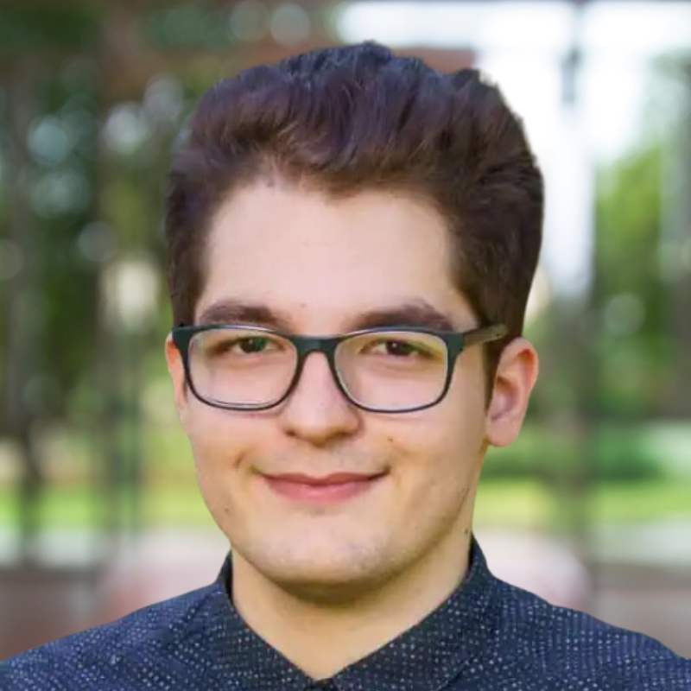
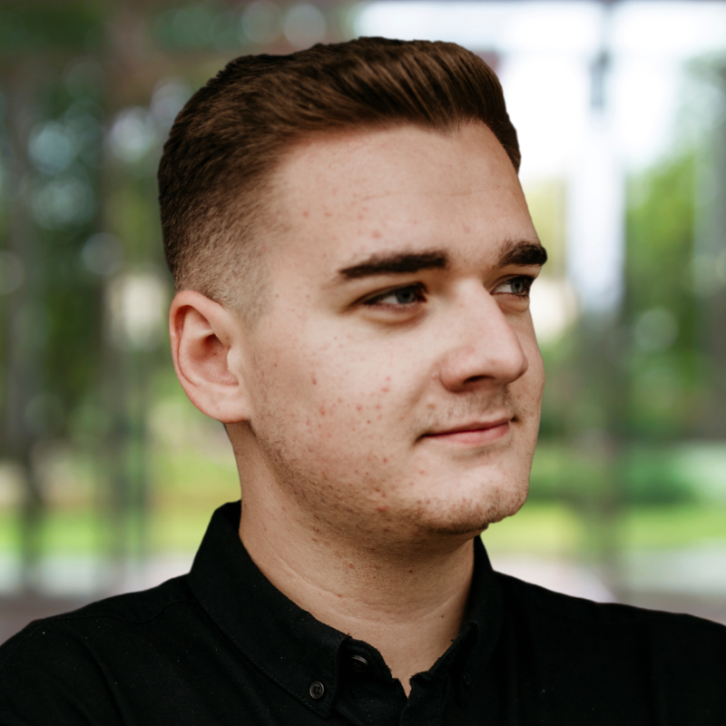
TOP 3 People Winning Garage Contests
Dan
GabiC
Mihai

Slide 27
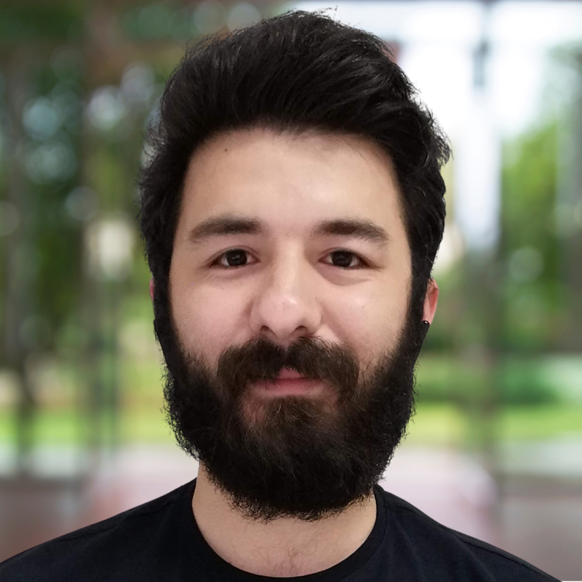
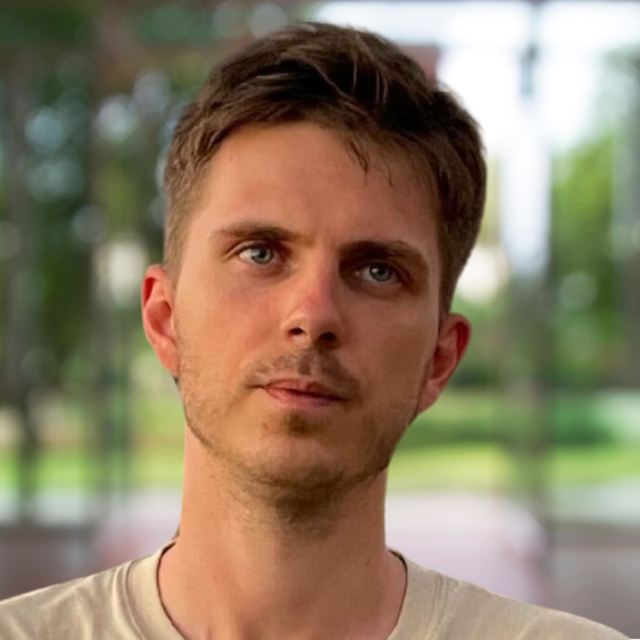
TOP 3 Slack MVPs Of The Year
Emoji Enthusiast: Mustafa
Wittiest Comments: Dumitru
Fun Channel Champ: Ovidiu

Slide 28
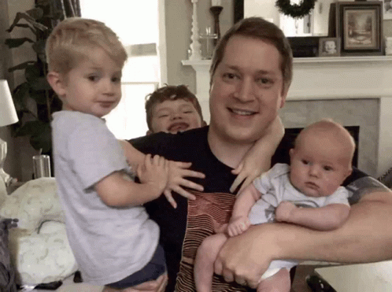
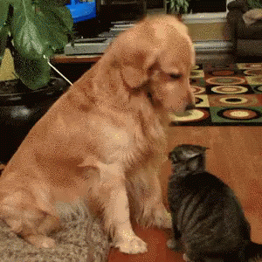
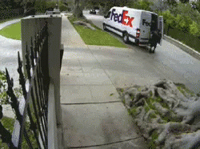
TOP 3 Work-From-Home Distractions
Kids
Pets
Deliveries

Slide 29

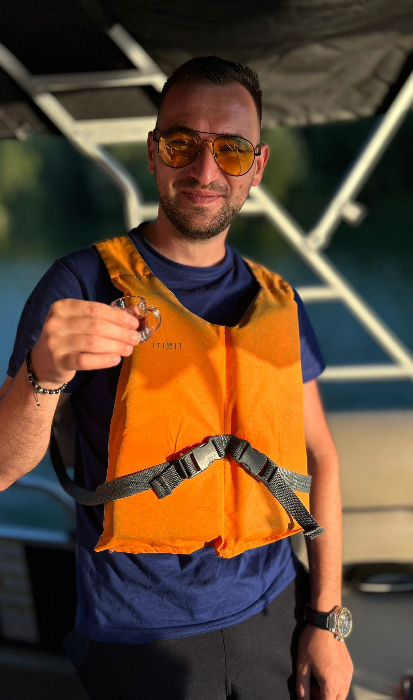
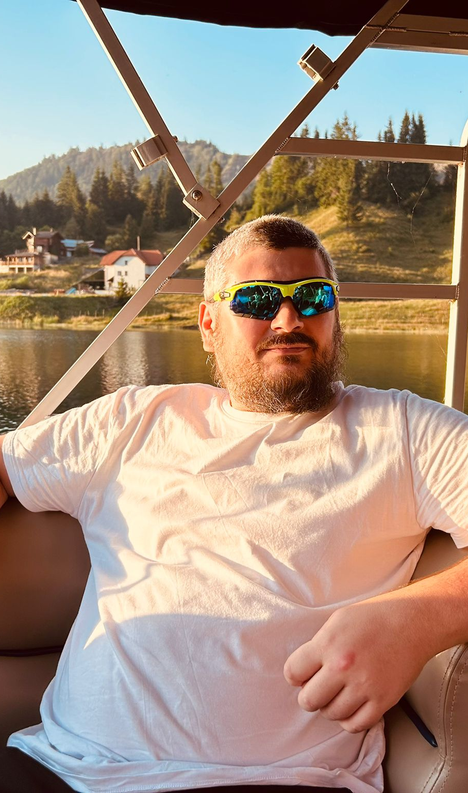

Slide 30
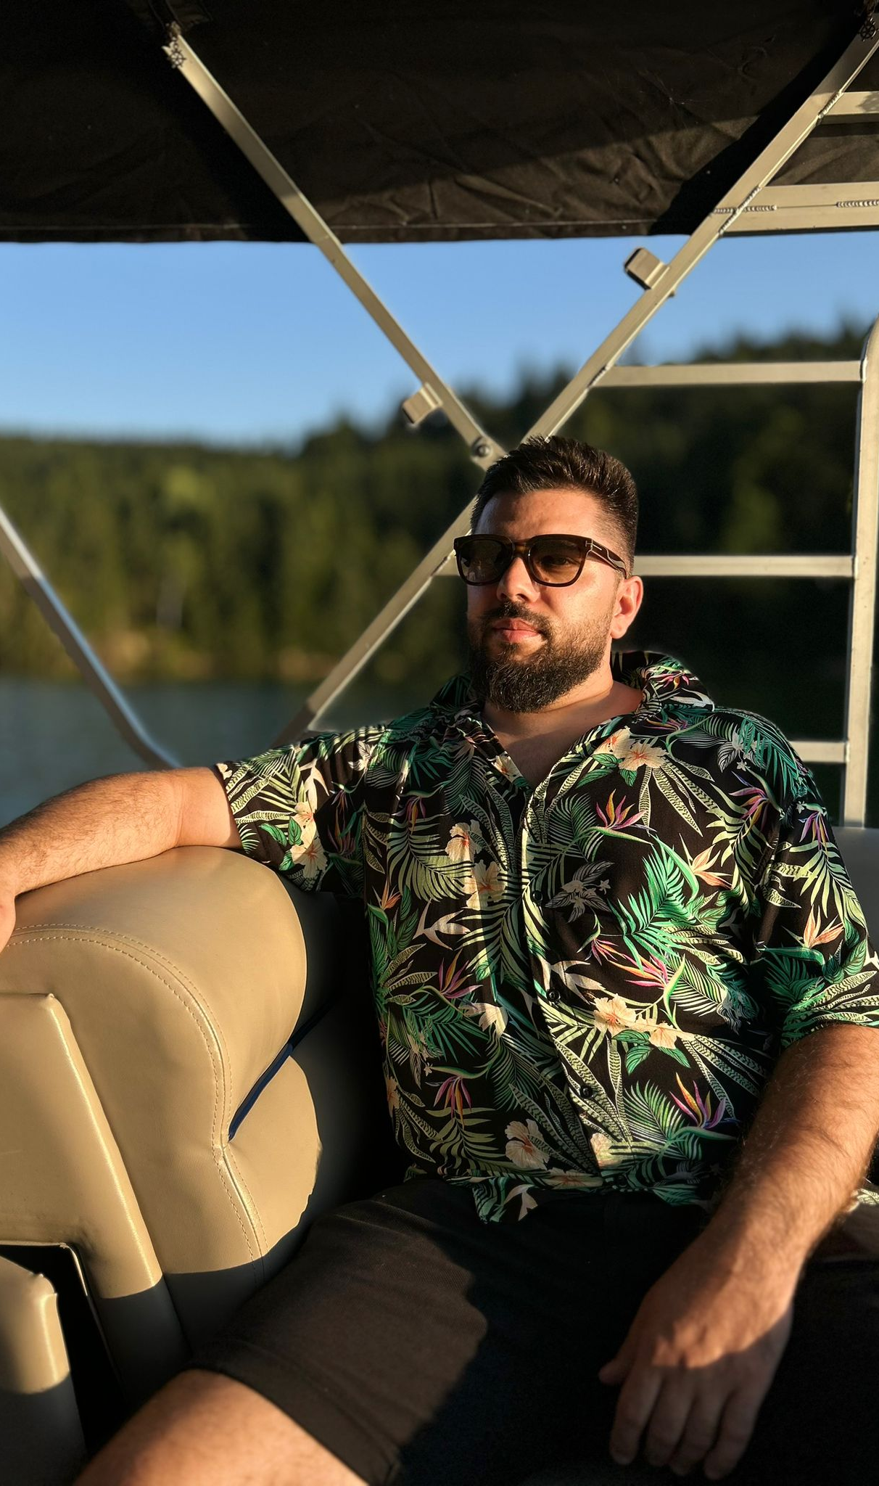

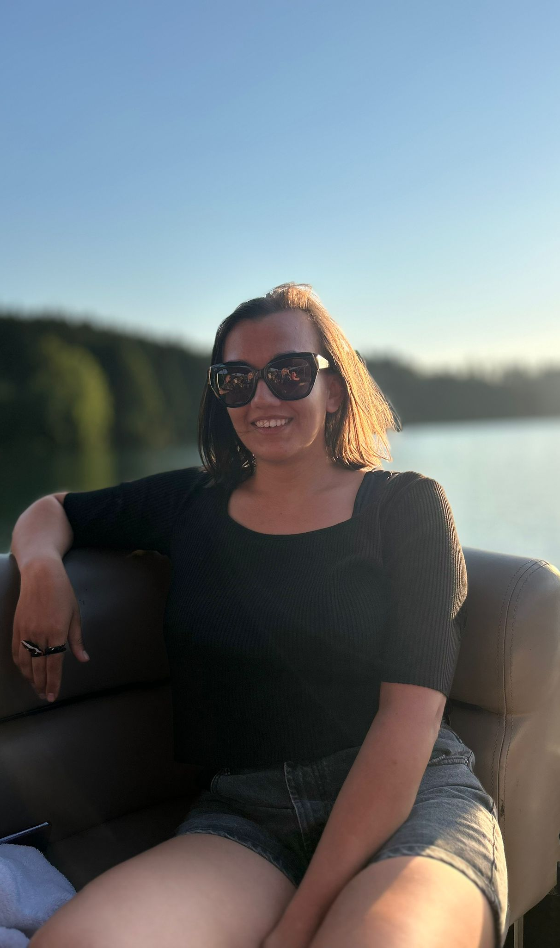

Slide 31
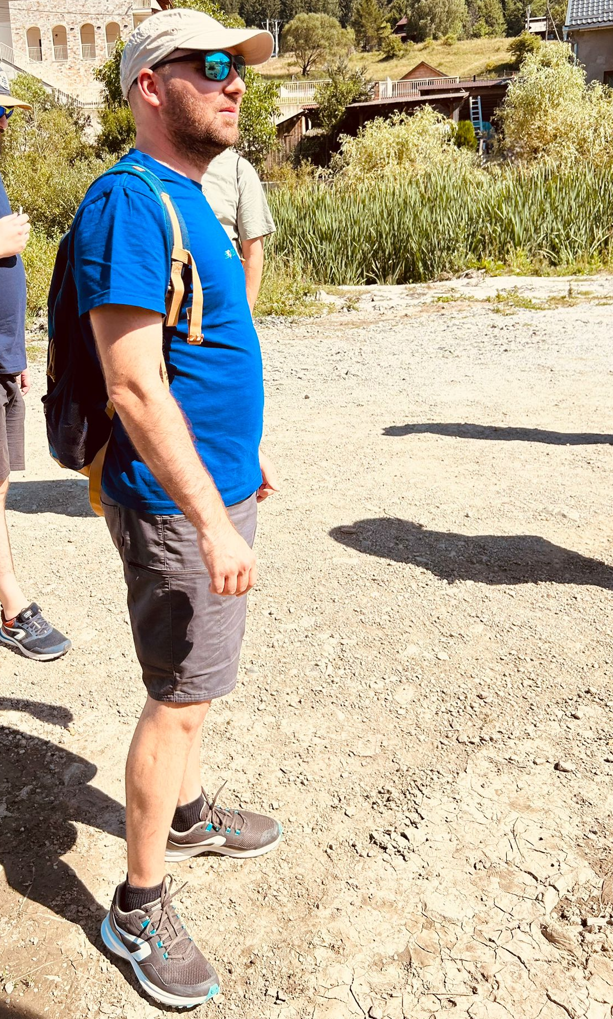
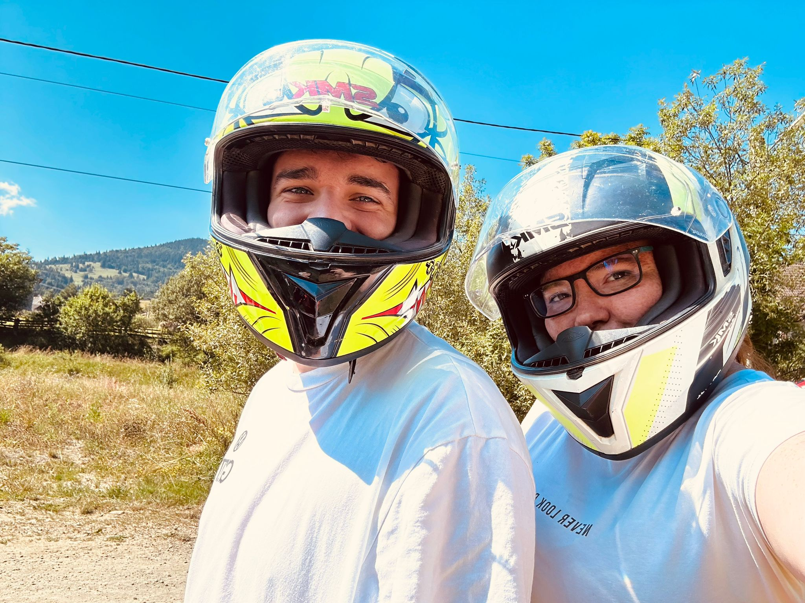

Slide 32
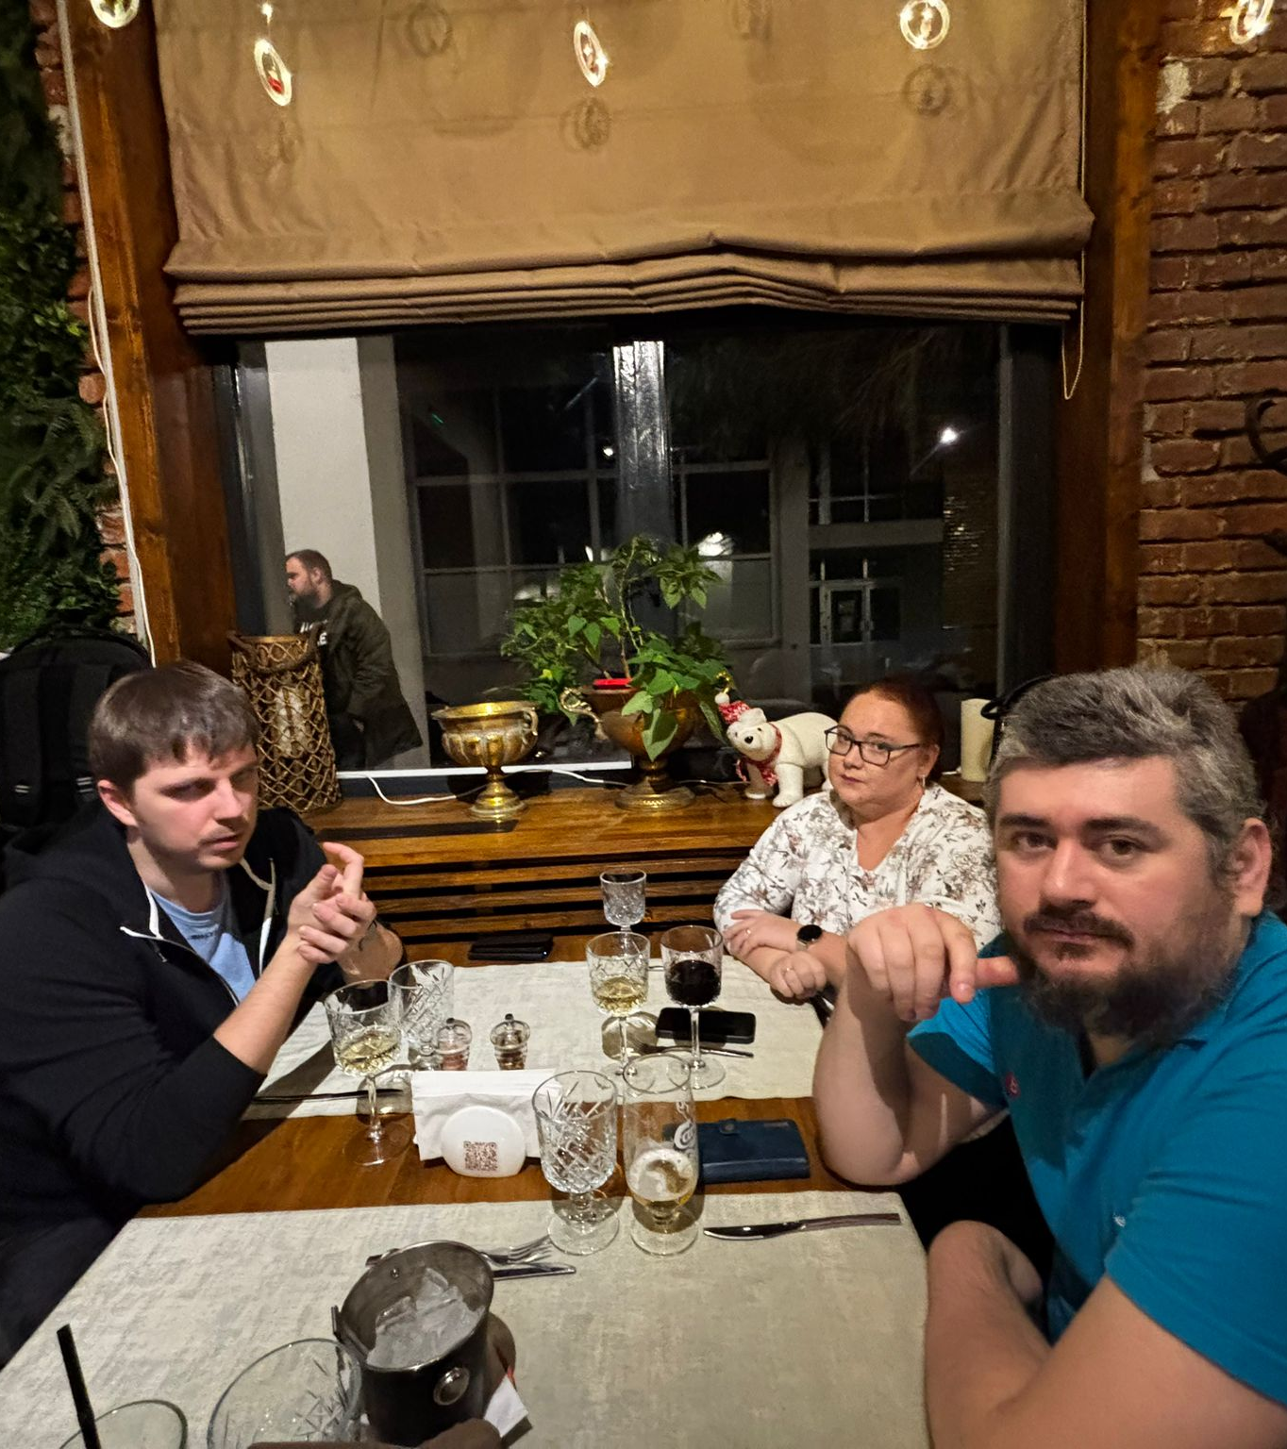
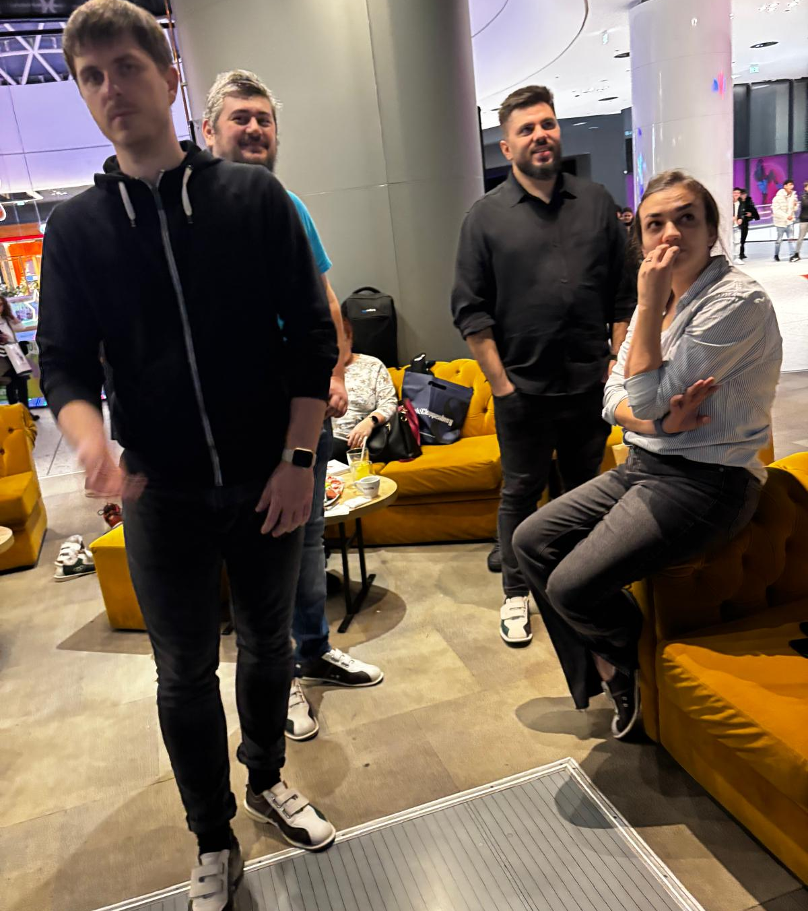

Slide 33
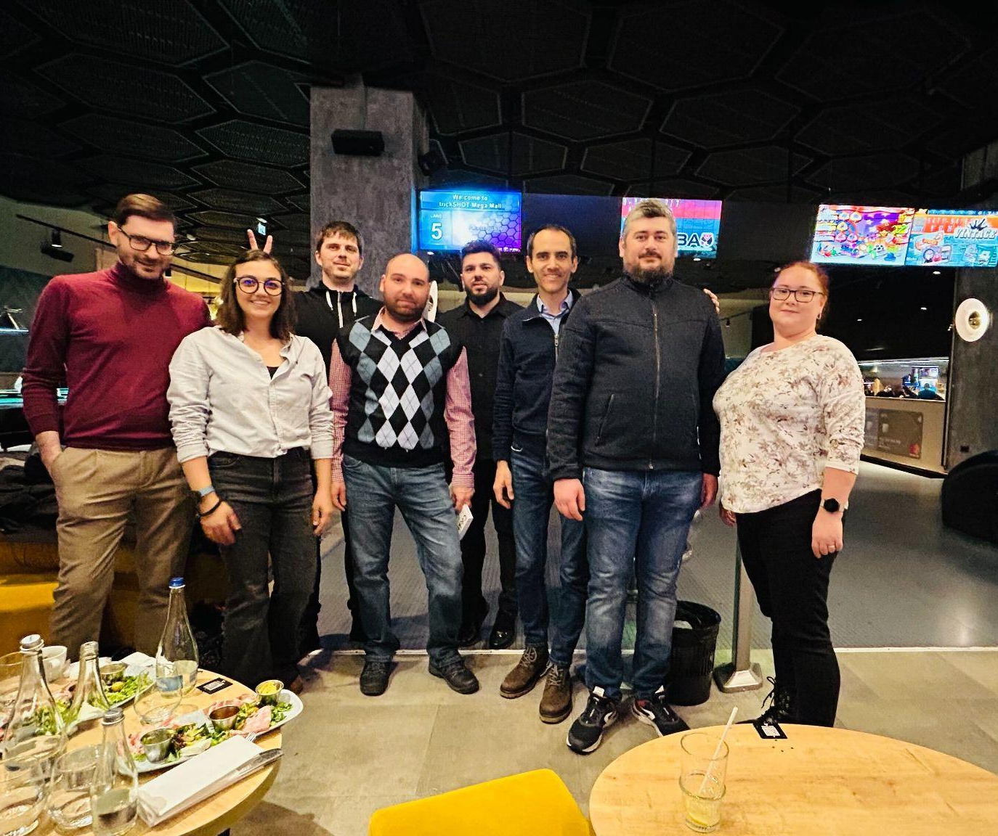
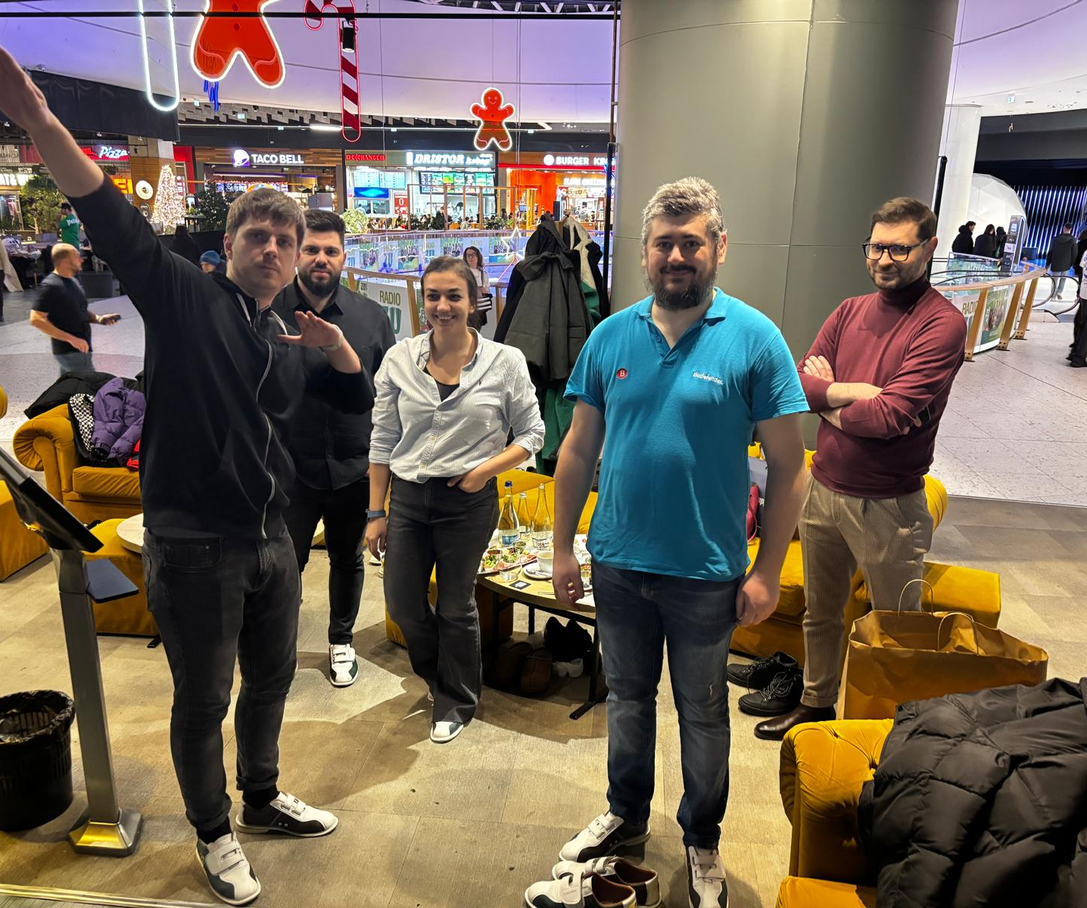
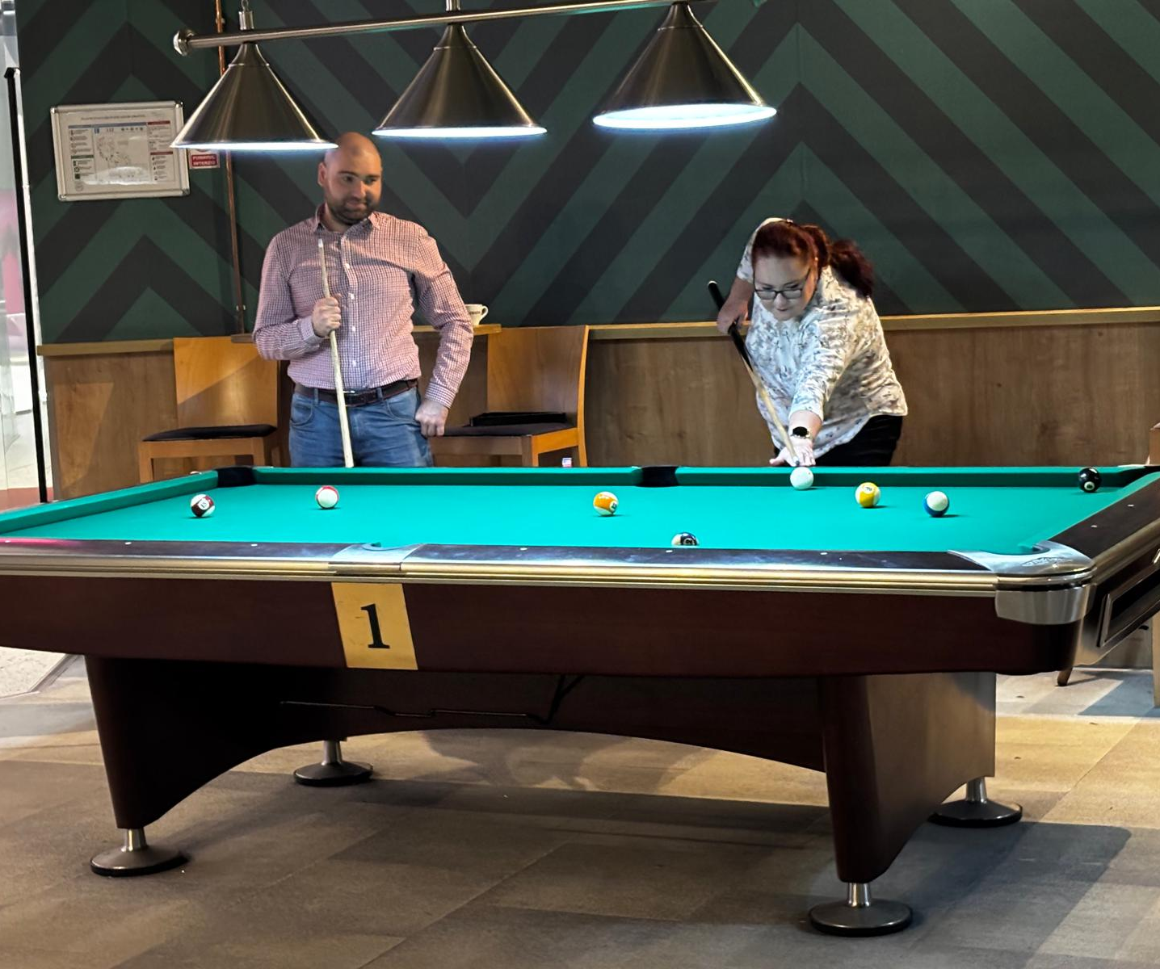
The year was good.
Are you ready for the last certificates for 2024?

Slide 34

The Innovation Overload Certificate
For delivering more groundbreaking ideas in a week than most people do in a year.

Slide 35

The Stress Doesn’t Exist
Certificate
For staying impossibly calm while juggling a hundred moving parts

Slide 36

The Fixer of all Things
Certificate
For being the go-to person when something, anything isn’t working

Slide 37
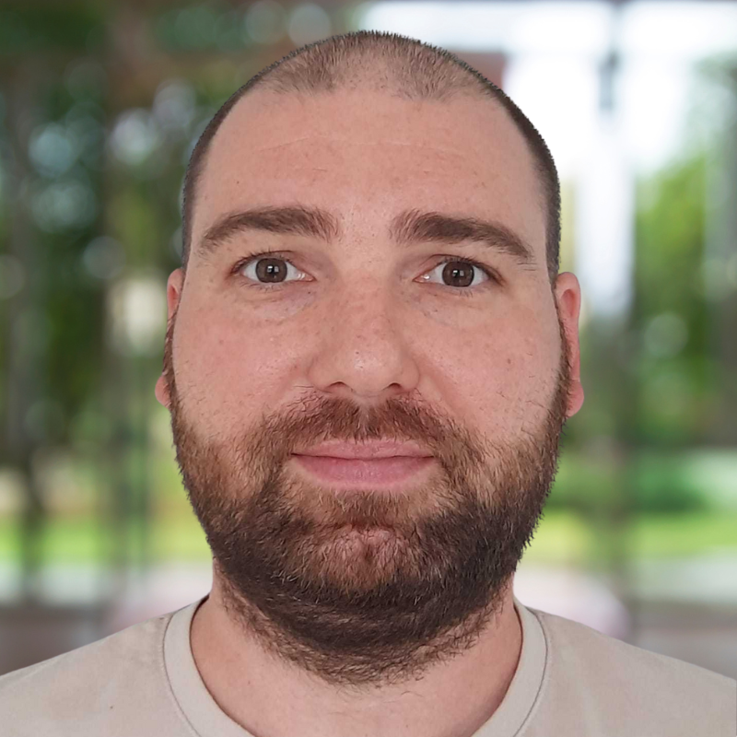

The Data Detective
Certificate
For spotting patterns in the data that Sherlock Holmes would have missed.

Slide 38

The Social Butterfly Wrangler
Certificate
For making even the grumpiest coders look like rockstars on social media.

Slide 39

The Retention Rockstar
Certificate
For ensuring customers stick around longer than most Netflix subscriptions

Slide 40

The Escalation Expert
Certificate
For soothing frustrated customers before they even realize they were upset.

Slide 41
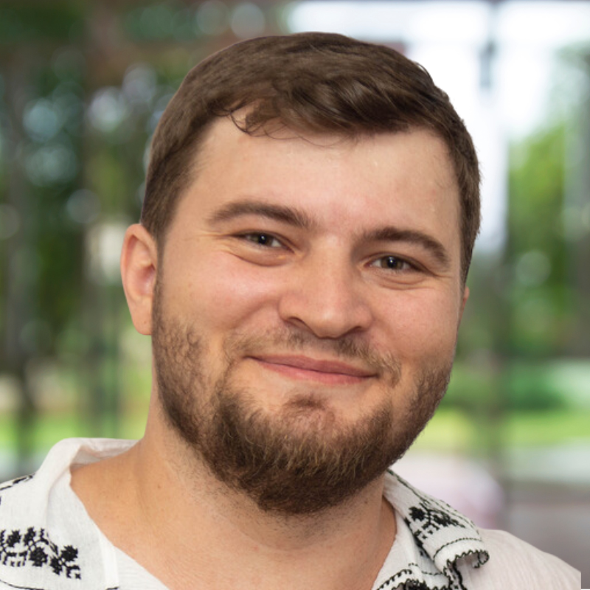

The Figma Philosopher
Certificate
For spending hours wondering: Is this design perfect, or just really good?

Slide 42
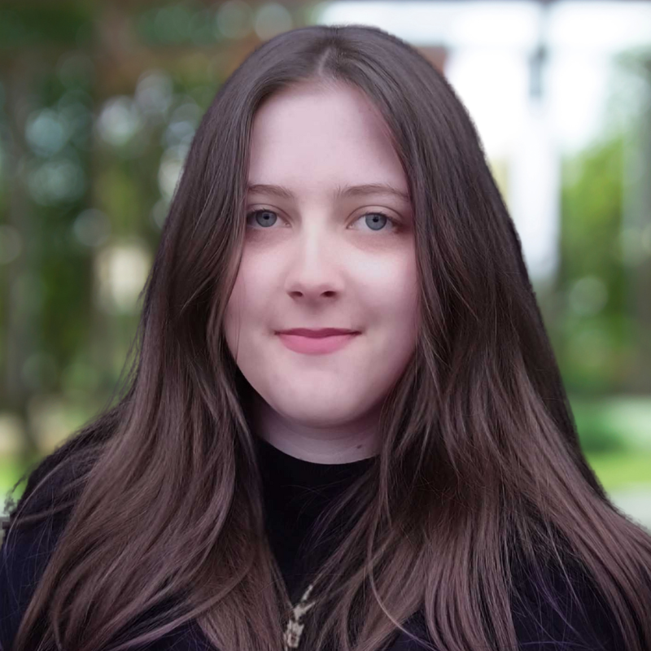

The Mockup Magician
Certificate
For turning vague ideas into stunning visuals that WOW the whole team.

Slide 43

The Bug Buster Extraordinaire
Certificate
For finding and eliminating bugs the devs swore weren’t there

Slide 44

The One-Man Band
Certificate
For creating entire features solo, like an orchestra of one.

Slide 45
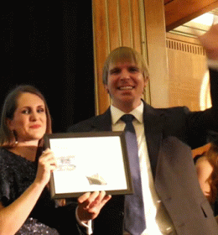
The Digital Swiss Army Knife
Certificate
For being ready to solve anything from a CSS glitch to a database meltdown.

Slide 46

The Meeting Escapologist
Certificate
For managing to avoid every non-essential meeting without anyone noticing.

Slide 47
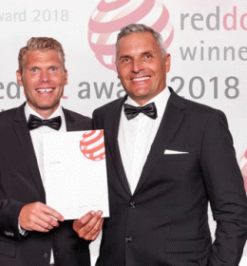
The All-Purpose Wizard
Certificate
For magically solving both big and small issues without breaking a sweat.

Slide 48
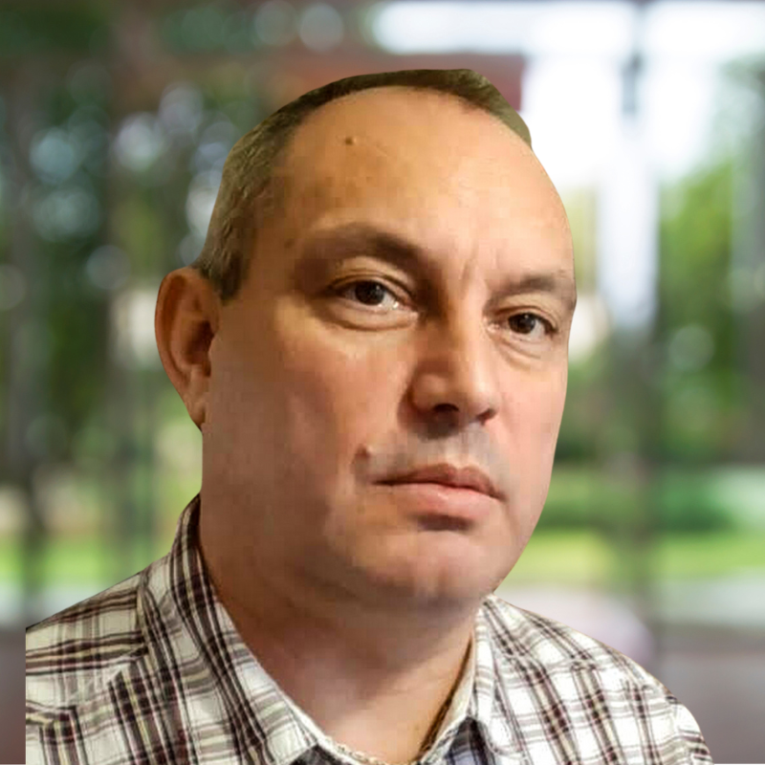

The Half-Full Glass
Certificate
For staying optimistic even when nothing is working.

Slide 49
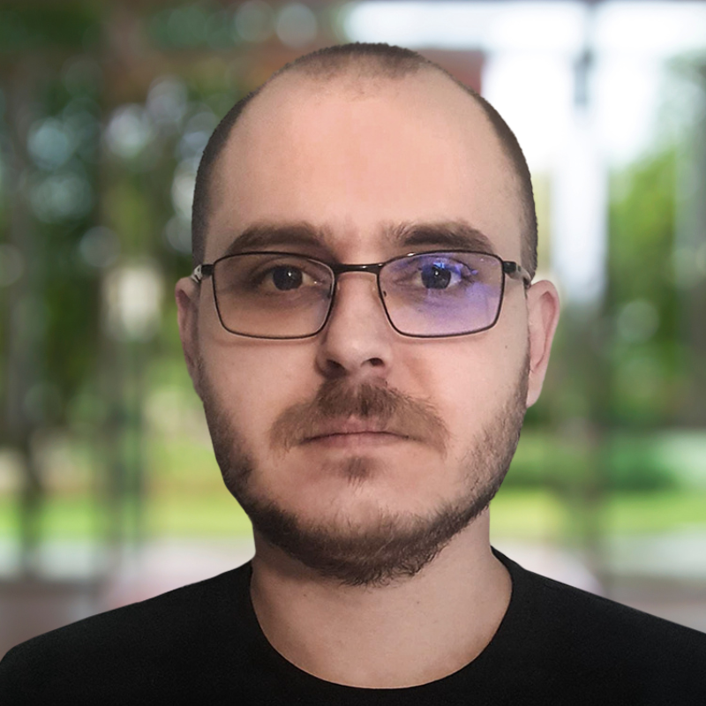
The 24/7 Code Machine
Certificate
For always being available to solve problems... even when they shouldn’t be.

Slide 50

The Can Do Everything, But Should I?
Certificate
For questioning why they’re asked to fix every bug on both sides of the stack.

Slide 51

The Code Whisperer
Certificate
For speaking both frontend and backend fluently, and probably some third dialect no one knows.

Slide 52
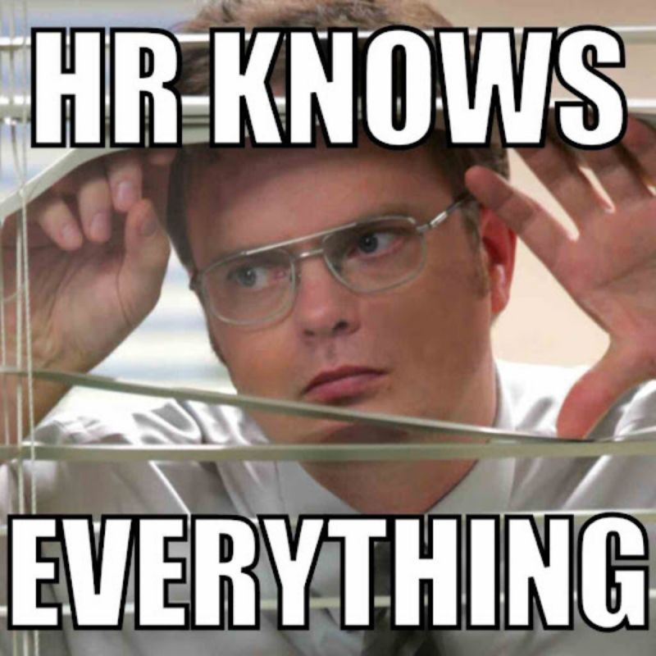
The Master of Organized Mayhem Certificate
For planning epic team events that made us forget about deadlines (at least temporarily) while still keeping the paperwork pile under control - basically holding the entire company together with duct tape and calendar invites!

Slide 53


Slide 54

May you have a wonderful 2025 year!
And start presenting awesome things at the Sharing Meeting next year! :D

