Slide 1


October 18 - November 15, 2023
Company updates and opportunities for WPRiders team members

Slide 2
WPRiders updates
October 18 - November 15, 2023

Slide 3
WPRiders updates
WPRiders Garage (our intranet) was officially launched garage.wpriders.com
  WPRiders handbook
  Give recognition form - show appreciation for your colleagues
We ended our collaboration with Florentin
Mihail finished his probationary period (last month). Congratulations! 💪
Dragos also finished his probationary period. Congratulations! 💪
We have 3 new colleagues from 🇷🇴
  Alex Cimpoeru - Development on Oraldo’s team [contractor]
  Alex Nedelcu - Design [contractor]
  Dan Grigorescu - QA on Dragos’s team [full time employee]
We have 27 Clients on retainers.
Plan your Christmas/New Year leave with Andrei

Slide 4
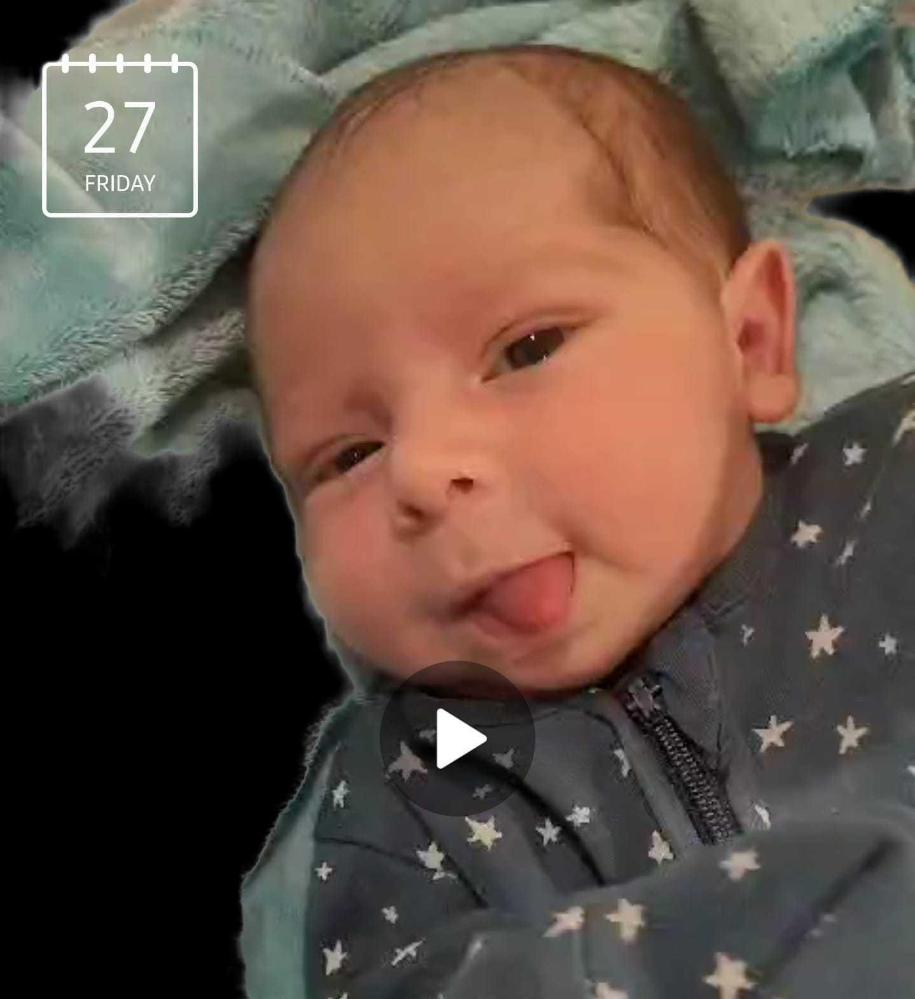
🎉🎉Felicia gave birth on October 27, 2023
Meet Sebastian👶🍼

Slide 5
Opportunities for you
We need:
1 Support person (contractor) who can answer tickets and perform small technical tasks on the US time zone between 6 pm Romanian and 2 am Romanian time.
1 Technical Consultant - will provide advisory for our customers
1 CTO ideally the person will grow from inside the company
—------
You can take AWS technical and commercial trainings and certification exams here.
If you need hardware, or software licenses, or even glasses so you can do your job better, please contact Alexandra.
If you want to read a book, or take a course, and want us to buy it - tell Alexandra.
If you refer somebody and we hire the person, you get a bonus after the trial period.

Slide 6
How do we get there? WPRiders accountability chart
Covered
Partially covered
Uncovered
General Manager
COO |  |  |  |  |  |  | Sales Manager |  |  | Marketing Director | HR Development Recruiting Team cohesion | Administrative & HR Manager Accounting & Legal & Financial
CTO
TEAM 1 CSM 1 - Customer Success Manager |  | TEAM 2 CSM 2 - Customer Success Manager |  | Technical Team Leader (Mihai) | Technical Consultant | CRO expert | Technical Sales Support (Oraldo) | Sales Account Executive | WordPress Business Analyst | SEO, Content, Marketing specialist | Technical Recruitment (Mihai)
Developers x3 | Tester x1 | Developers x3 | Tester x1

Slide 7


How do we work - our values
Accountability - We do our job well and we are reliable.
We work efficiently since we believe it is only up to us deliver on the promised results.
Integrity - We follow one simple rule - always do the right thing.
We are honest and open with our customers.
We keep our promises and treat our stakeholders with respect and consideration, just as we would want them to treat us.

Slide 8


How do we work - our values
3. Personal growth - We are passionate about our work.
We are also open to personal change and continuous improvement. That is why we constantly challenge ourselves to find new ideas and solutions in our pursuit of excellence.
4. Contribution - We are part of the Open Source community. We are determined and dedicated to its success. We gladly share our know-how as keynote speakers and our code to inspire and help others just as we were inspired and helped by the Open Source family.

Slide 9
Where do we want to go? -> Our vision
To be the super-star,
well-known agency for
ongoing WordPress development,
maintenance and support.

Slide 10



The
Of

Slide 11
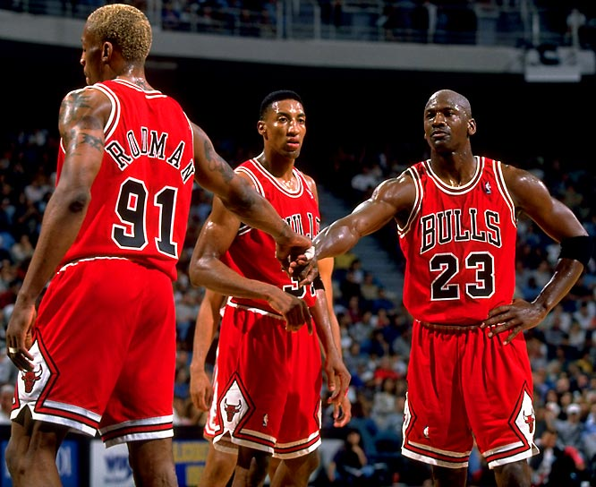

Slide 12
Our mission
WHERE DO WE WANT TO BE:
Reach 50 recurring customers who
Stay with us for at least 12 months and who
Consistently rate us with 5/5.

Slide 13
“People who work together will win, whether it be against complex football defenses, or the problems of modern society.”
~ Vince Lombardi

